Slide 1
Network Analysis
Practical Applications Using igraph in R
Roger Stanton

Slide 2
outline
What is a Network Graph?
Examples of Networks and Components
Motivation for Network Analysis
Creating a Simple Network
Relationships Between Vertices
Vertex Importance and Influence
Degree
Betweenness
Eigenvector Centrality
Network Pattern & Structure
Network Substructures
Network Randomization
Assortativity
Code Review

Slide 3
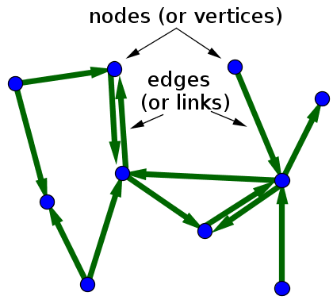
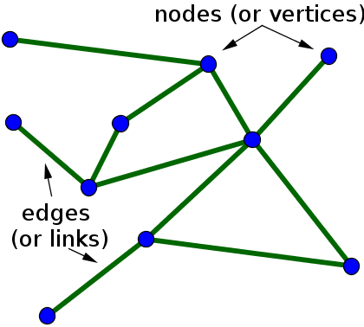
What is a network graph?
Directed
Undirected
Email Exchanges
Friend relationships
Notes:
A network graph consists of nodes (or vertices) and edges (or links). The vertices are the set of objects connected together. The edges are the connections between the vertices. Information can be captured in the nodes as well as the edges via their attributes. What makes a network graph unique is the association between nodes is captured – i.e. the edges are important! These edges are either directed or undirected. Loops are also possible. In general, we are interested in the degree of each vertices. For an undirected graph the degree is the total number of edges connected to the vertices. For a directed graph we can also calculate the “in degree” and “out degree.”
Network Image Source: https://mathinsight.org/definition/network

Slide 4
EXAMPLES OF NETWORKS and COMPONENTS
NETWORK | VERTICES | VERTEX ATTRIBUTES | EDGES | EDGE ATTRIBUTES
Airlines Network | Airports | Footfall, Terminals, Staff, City Pop | Airplanes / Routes | Frequency, # Passengers, Fuel Usage
Banking Network | Account Holders | Name, Demographics, Products, Balance | Transactions | Type, Amount, Time, Location, Device
Social Network | Users | Name, demographics, # connections, likes | Interactions | Time, Duration, Topic, Type of content
Supply Chain Network | Warehouses | Location, size, capacity, storage type | Trucks | Load capacity, miles travelled, cost
Notes:
Table derived from: https://www.analyticsvidhya.com/blog/2018/04/introduction-to-graph-theory-network-analysis-python-codes/
We live in a world of networks! A variety of systems can be modeled using networks and analyzed using network analysis techniques.

Slide 5
Motivation for network analysis
Network | Use Case
Banking Network | Fraud Prevention: detect unusual patterns in the movement of money across the network
Supply Chain Network | Optimum Route Selection: calculate optimum routes for delivery to minimize cost or delivery time
Social Network | Marketing Analytics: discover influencers within social networks (i.e. highly connected people) to optimize use of available advertising dollars
Notes:
Network analysis is a powerful way to anchor other analyses. It can be used to solve the “where do I start looking” problem. It is also a powerful forensic tool.

Slide 6
Creating a simple network
Vertices LIST
EDGE LIST
Station | Num Bikes
A | 5
B | 5
C | 7
D | 8
E | 4
F | 12
G | 6
From | To | Frequency
A | B | 2
A | D | 15
B | D | 3
A | C | 6
C | E | 8
C | F | 11
C | G | 13
E | F | 3
F | G | 1

Slide 7
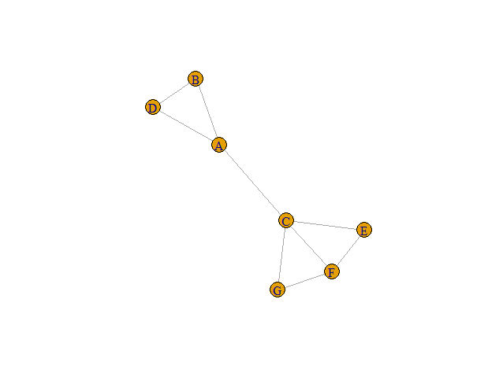
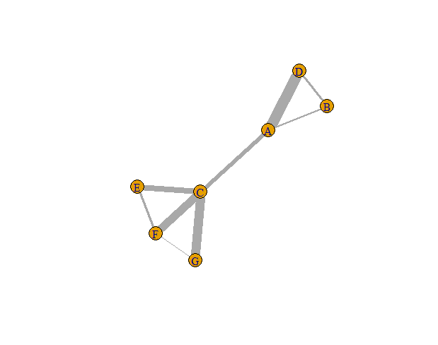
Creating a Simple network
Notes:
The plot to the left is a basic network graph depicting the vertices and edges. The plot to the right applies an edge weight to the line thickness based on the frequency attribute. The visual power of network graphs is apparent. One can immediately pick out which vertices have frequent connections.

Slide 8
Relationships Between Vertices
Neighbors
  Directly connected vertices
Intersection
  Indirectly connected vertices
Diameter
  Longest path length through the network
  Diameter = 3
Notes:
The neighbors for A consist of D,B, & C. We might also be interested in understanding which vertices share a common neighbor. We can find common neighbors using the intersection function. The common neighbor between B and C is A. The diameter is the longest path length through the network. Each edge has a geodesic distance of 1. In this network the diameter is 3.

Slide 9
VErTEX Importance & INFLUENCE
Degree
  Number of connections.
Betweenness
  How frequently does a vertex lie on the shortest path between two vertices (i.e. the key bridges in a network)
Eigenvector Centrality
  How interconnected are the vertices to which a particular vertices is connected (i.e. are your connections highly interconnected?)
Notes:
Most networks of interest are too complex to be dissected visually. In general we’d like to focus on vertices that are considered important. There are several measures of importance/influence to include degree, betweenness, and eigenvector centrality. There are other measures that will not be discussed to include closeness centrality and pagerank centrality. In all cases we need to understand what type of network we are analyzing before making claims about vertex importance/influence!

Slide 10
Degree
Definition
Example
The total number of edges connected to a vertices
In a directed network we can discuss “in-degree” and “out-degree”
A vertices with a large degree is well-connected within the network and may be of high importance/influence.
A | B | C | D | E | F | G
3 | 2 | 4 | 2 | 2 | 3 | 2
Notes:
Upon inspection we see that C is an important vertices which is supported by its high degree. But what about A and F? They both have the same degree but clearly A appears to be more critical.

Slide 11
Betweenness
Definition
example
The frequency with which a vertex lies on the shortest path between two vertices.
High betweenness implies the vertex is a critical bridge in the network.
A | B | C | D | E | F | G
0.53 | 0.0 | 0.63 | 0.0 | 0.0 | 0.03 | 0.0
Notes:
As suspected, C has the highest betweenness. It is clearly a bridge between two separate “neighborhoods” in this network. However, we also see that A has a high betweenness and F has a low betweenness. Based on degree alone we could not distinguish between A and F. I will discuss clustering on edge betweenness in a later slide.

Slide 12
EIGENVECtOR CENTRALITY
definition
example
Measure of the connectedness of a vertex.
Obscure vertices may have a high centrality because they are connected to highly connected vertices.
A | B | C | D | E | F | G
0.61 | 0.34 | 1.0 | 0.34 | 0.66 | 0.84 | 0.66
Notes:
Eigenvector centrality reveals that nodes F, E, & G (which did not stand out in degree or betweenness) had high eigenvector centrality. This is because they are connected to each other and also connected to C.

Slide 13
Network Pattern & Structure
Density
  Proportion of edges that do exist out of the total number of edges that could exist.
  Density = 0.43
Average Path Length
  Mean of the shortest path length between all pairs of vertices in the network.
  Average Path Length = 1.86

Slide 14
Network substructures
Closed Triads
  Groups of three vertices that are interconnected
  ABD, CGF, CFE
Transitivity
  The probability that the adjacent vertices of a given vertices are interconnected
    Global Transitivity = 0.56
    Local Transitivity (F) = 0.67
Notes:
The micro-features of a network can shed light on how a network functions. We can examine the network and see how many closed triads the network contains. We see here that we have 3 closed triads. We can also calculate the network transitivity which is the probability that the adjacent vertices of a given vertices are interconnected. The global transitivity is 0.56. The local transitivity (i.e. the transitivity for a specified vertices) can also be calculated. In this example, F, is adjacent to G, C, & E. G,C,E is not a closed triad and there are only two of possible three edges. Therefore, the transitivity of F is 2/3. Another way to look at local transitivity is proportion of closed triads the vertices could be a part of out of the total number it could be a part of.

Slide 15
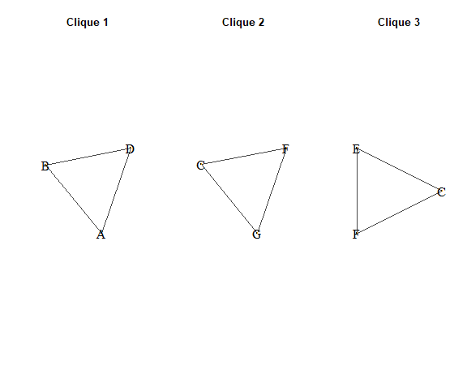
Network substructures
Cliques
  Every vertex is interconnected with every other vertex.
  Example simple network has three triads as the largest cliques.
Notes:
The simple network has 3 cliques of size 3. If G & E were connected then the largest clique would be C,E,F,G. From an analytics perspective, depending on the nature of the network, we might want to understand why F&G are not connected.

Slide 16
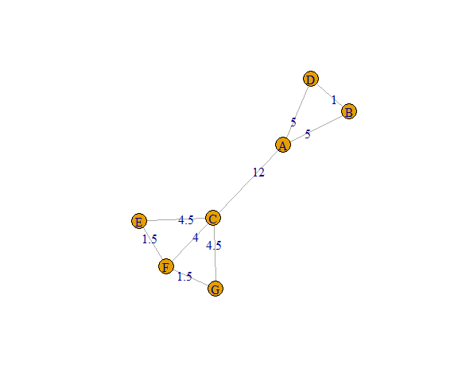
NETWORK SUBSTRUCTURES
Modules
  Distinctly interconnected subgraphs
  Edge betweenness community based structure detection = edges connecting separate communities will have a high edge betweenness
  Systematically removes the edges with the highest betweenness to find modules
Notes:
Using the edge betweenness we can see that two communities

Slide 17
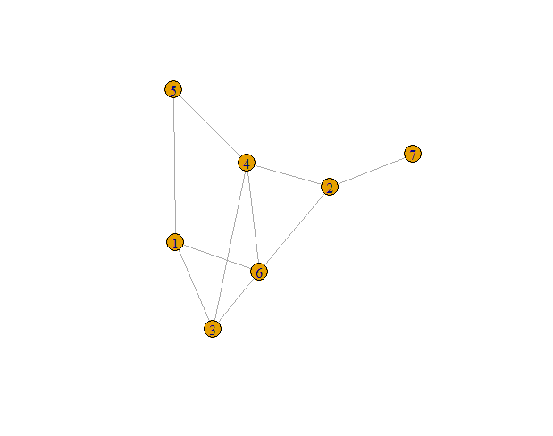
Network Randomization
simple network
Random network

Slide 18
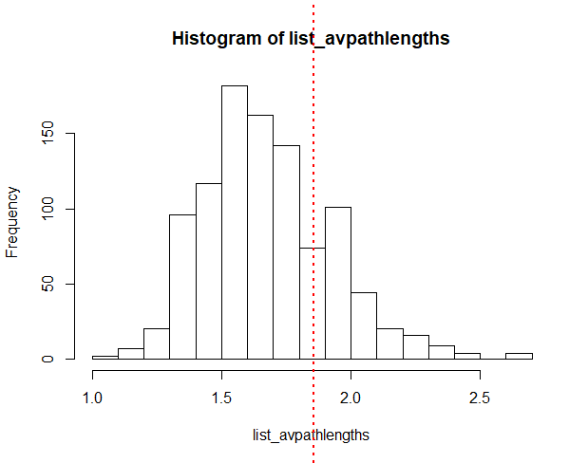
Network randomization
Create random graphs (1000) with the same number of vertices (7) and density (0.43)
Determine the average path length for each random network.
Compare to the average path length of the original network (1.86)

Slide 19
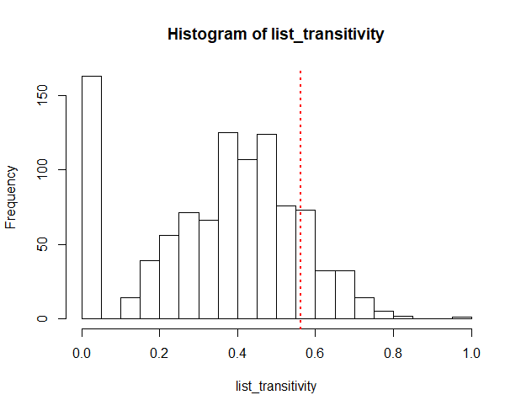
Network randomization
Create random graphs (1000) with the same number of vertices (7) and density (0.43)
Determine the global transitivity for each random network.
Compare to the global transitivity of the original network (0.56)

Slide 20
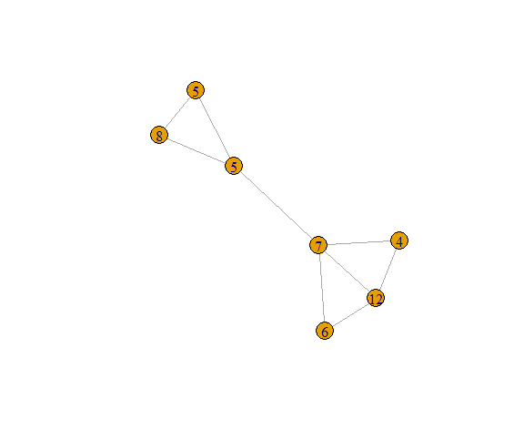
Assortativity
Measure of how likely similar vertices will connect with each other.
  Similarity is determined by vertex attribute
Ranges from -1 to 1
  1 = similar vertices seek each other out
  -1 = similar vertices avoid each other
Assortativity = -0.36
Notes:
The vertex attribute in question is the number of bikes at a station. The simple network is relabeled with number of bikes at each station. The assortativity coefficient is -0.36 which means stations smaller numbers of bikes are more likely connected to stations with a large number of bikes. The bike numbers ought to be binned and assigned a numerical factor to make sense.

Slide 21
CODE REVIEW

Slide 22
REFERENCES
Leskovec, Jure. Mining Massive Data Sets. 2014.
https://igraph.org/r/doc/igraph.pdf
https://mathinsight.org/definition/network
https://www.analyticsvidhya.com/blog/2018/04/introduction-to-graph-theory-network-analysis-python-codes/

