Slide 1
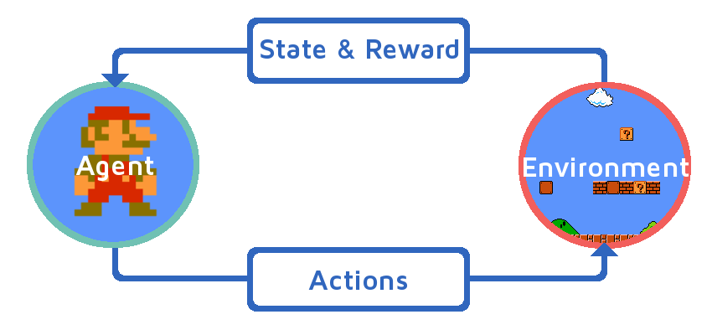
Reinforcement Learning
Zohreh Raziei
Spring 2019

Slide 2
Outline
Reinforcement Learning
Multi-armed Bandit Problems
Upper Confidence Bound (UCB)
Thompson Sampling
R code Implementation
Comparison UCB and Thompson Sampling

Slide 3
What is reinforcement learning?
Types of Machine Learning
Supervised
Unsupervised
Reinforcement
Task driven -Regression/Classification
Data driven – Clustering &
Dimensionality reduction algorithms
Learns to react an environment- find the best ways to earn the greatest reward.

Slide 4
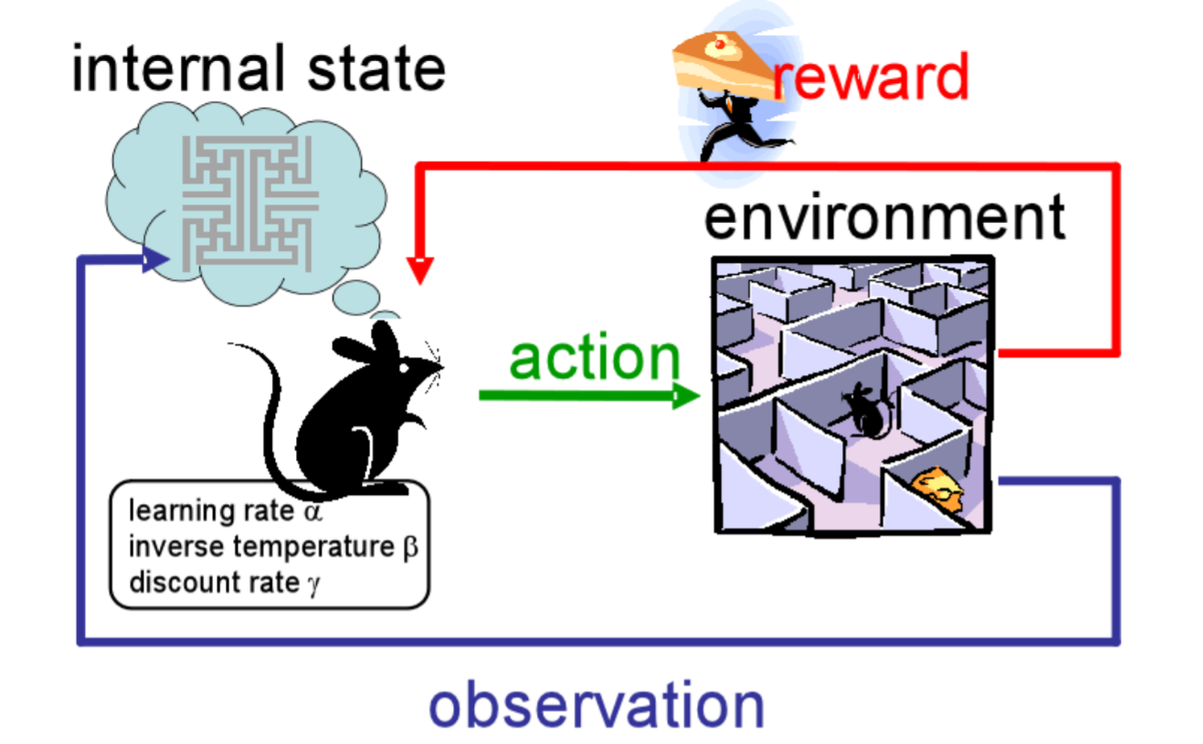
What is reinforcement learning?
No explicit training data set.
Nature provides reward for each of the learners actions.
At each time,
Learner has a state and choses an action.
Nature responds with new state
and a reward.
Learner learns from reward and
makes better decisions.
Every game is a sequence of states, actions, and rewards

Slide 5
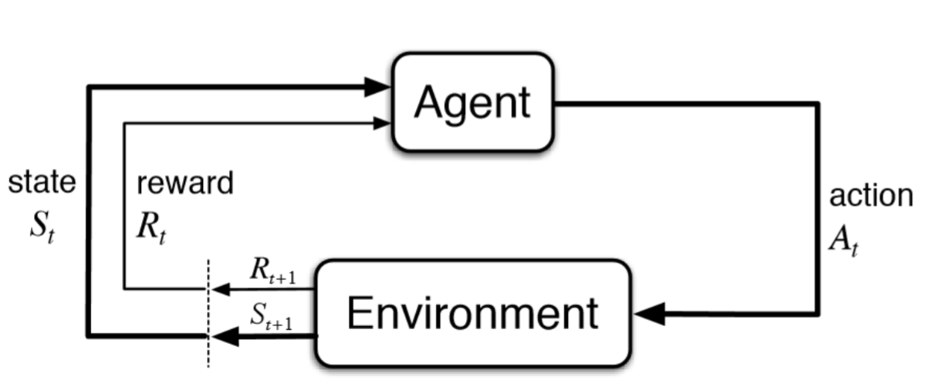
What is reinforcement learning?
Convention: start at state ($S_{t}$), take action($A_{t}$) , and received a reward of ($R_{t+1}$)
Rewards always results from (s,a) you took at previous one.
$S_{t}$ and $A_{t}$ also bring you a new state, $S_{t+1}$
This makes the triple ($S_{t} ,A_{t}$, $S_{t+1}$)

Slide 6
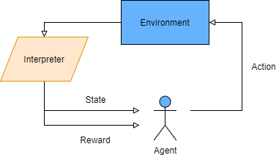
What is reinforcement learning?
We can never be sure, if we will get the same rewards the next time we perform the same actions. The more into the future we go, the more it may diverge
Main goal is to maximizing the reward $R_{t}$
iis the discount factor between 0 and 1.
The more into the future the reward is, the less we take it into consideration.
Simply:

Slide 7
Multi-armed Bandit Problems
We have multiple slot machine
How do you figure out which ones of them to play in order to maximize your returns
Each machine has a distribution behind it (unknown reward probabilities)
The goal is to figure out which of these distributions is the best one
Fine a trade off between exploration (collect data) and exploitation (playing “best-so-far” machine )

Slide 8
Multi-armed Bandit Problems
We have d arms. For example, arms are ads that we display to users each time they connect to a web page.
Each time a user connect to this web page, the make a round.
At each round n, we choose one ad to display to user.
At each round n, ad i gives reward $r_{i}\left(n\right)∈\left\{0,1\right\}: r_{i}\left(n\right)=1$ if the user click on the add i, 0 if the user didn’t
Our goal is to maximize the total reward we get over many rounds

Slide 9
Traditional A/B Testing
Predetermine number of time you need to play/collect data in order to establish statistical significance
# of time needed is dependent on numerous things, like difference between win rates and each bandit
But if you knew that, you would not be doing the test
The important things is don’t stop the test early (sub-optimal solution)
Choosing small sample size results in non-convenient results.
Looking for method that is better than A/B test (creating sub-optimal solution)

Slide 10
Upper Confidence Bound (UCB)

Slide 11
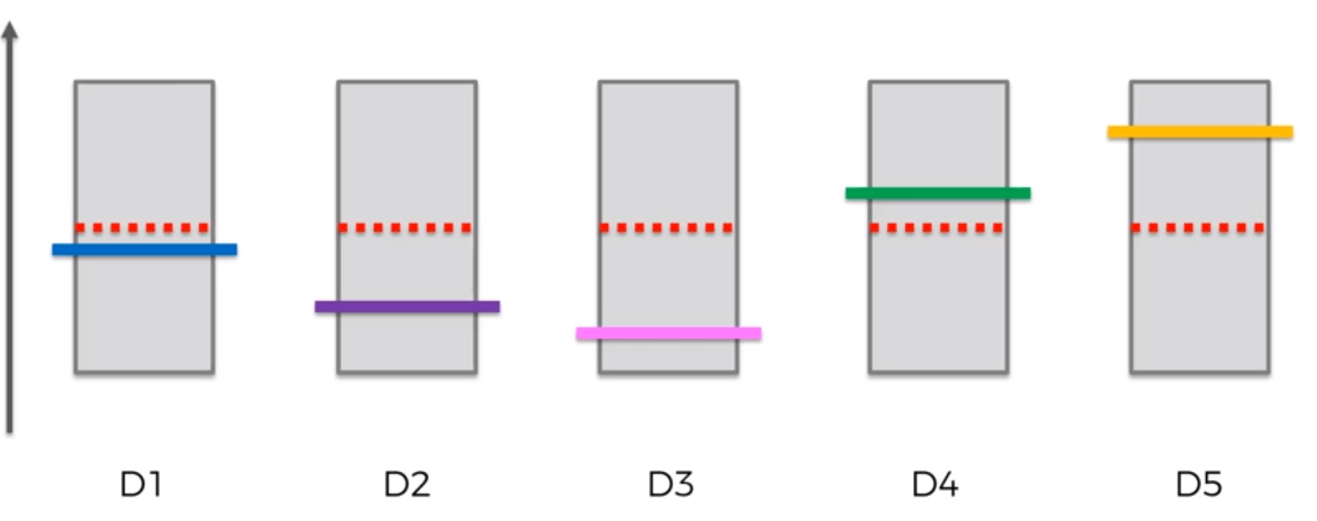
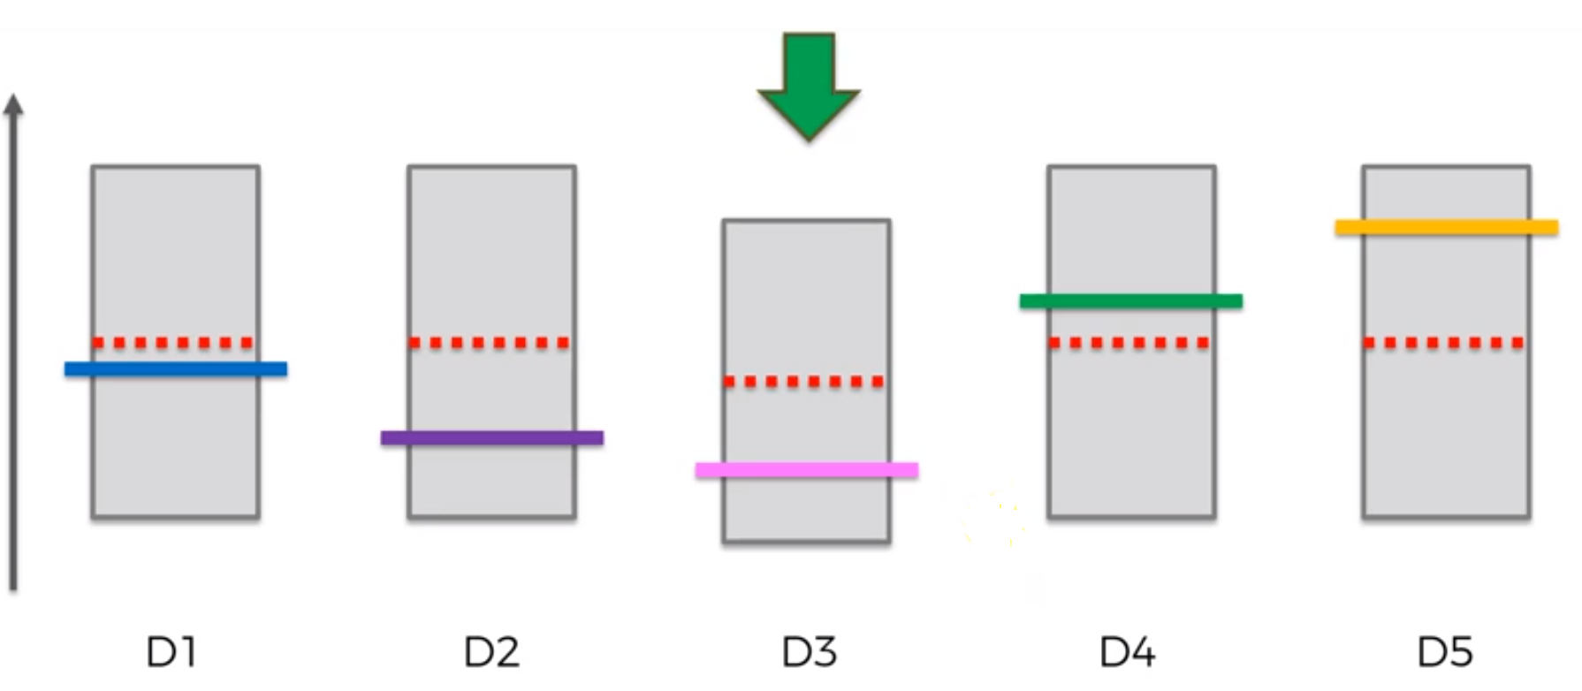
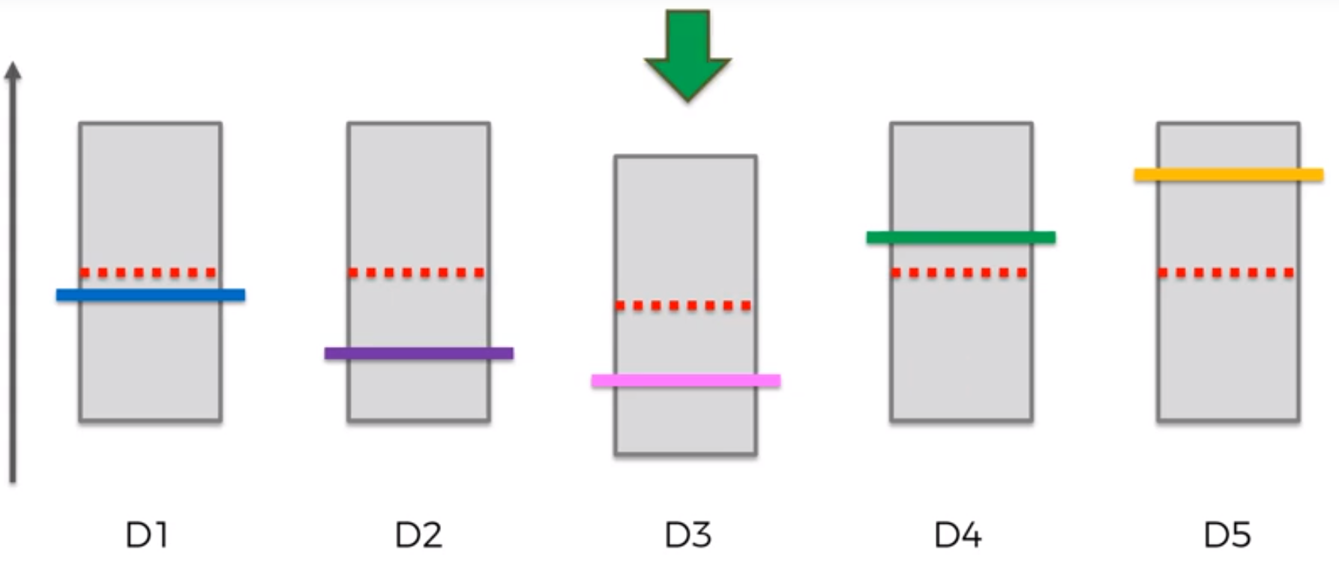
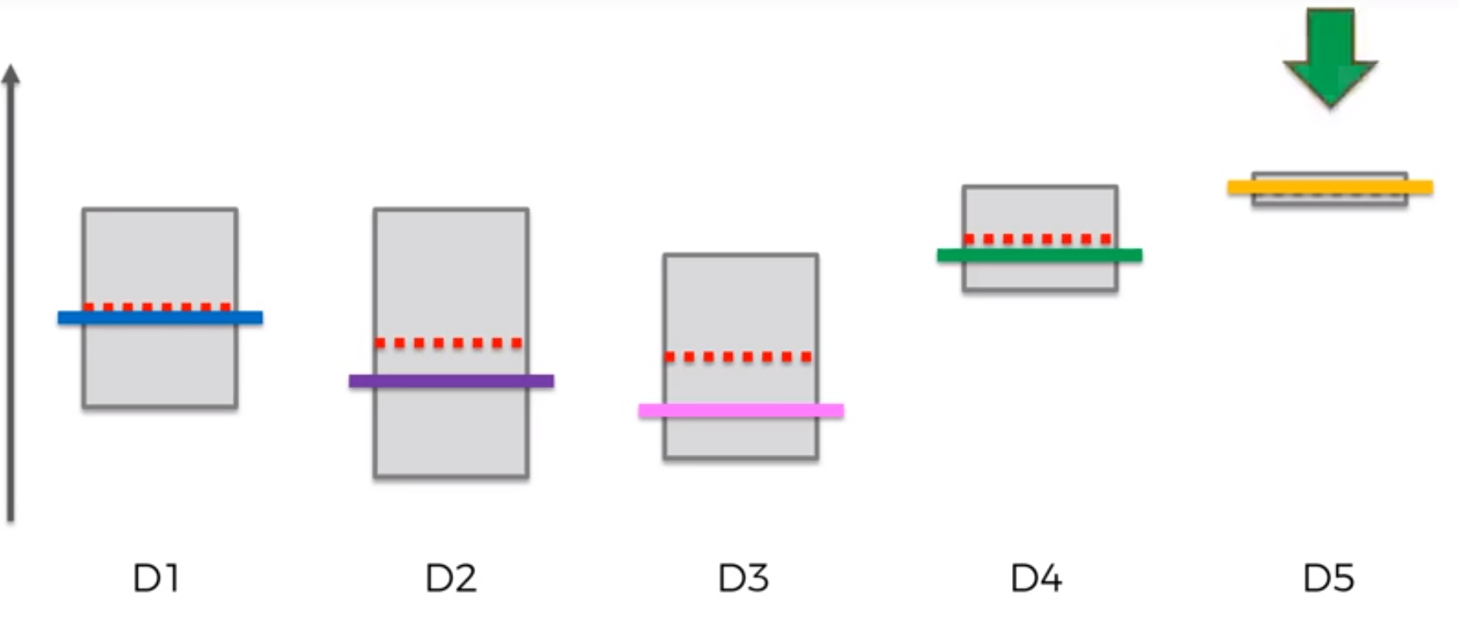

Slide 12
Thompson Sampling

Slide 13
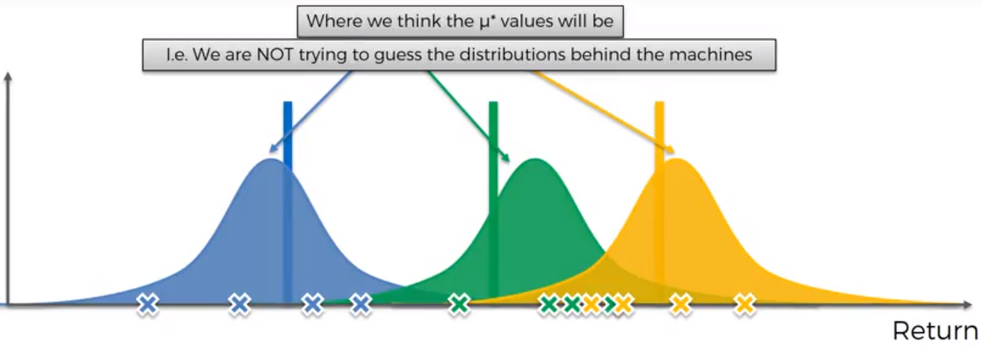
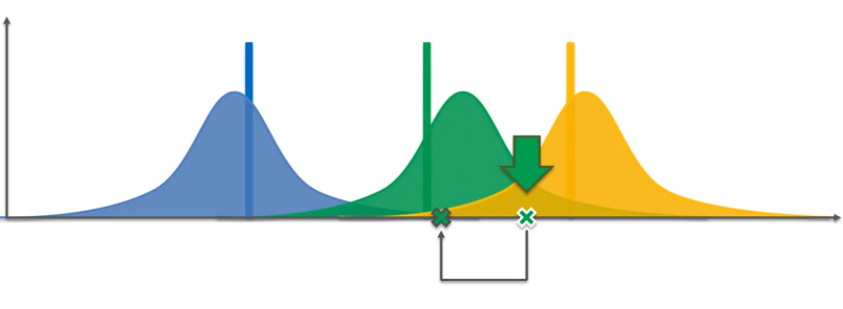
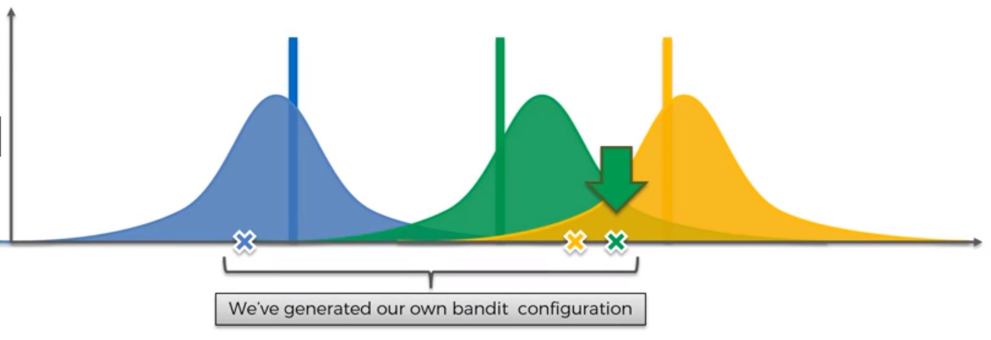
We're adjusting our perception of reality based on the new information that generates

Slide 14
Bayesian Inference
Ad i gets rewards y from Bernoulli distribution $p\left(y \right|θ_{i}) \sim B(θ_{i})$
$θ_{i}$ is unknown, but we set its uncertainty by assuming it has a uniform distribution $p\left(θ_{i}\right)\sim Uni([0,1])$, which is the prior distribution
Apply Bayes Rule to find posterior distribution ($p\left(y \right|θ_{i})$)
So, we get $p\left(y \right|θ_{i}) \sim β(numbr of successes+1 , number of failures+1)$
At each round n we take a random draw $θ_{i}(n)$ from this posterior distribution $p\left(y \right|θ_{i})$, for each ad i
At each round n, we select the ad i that has the highest $θ_{i}(n)$
The aim is to estimate the parameter $θ$, that is the probability of success for each ad i

Slide 15
Problem Definition for UCB and Thompson Sampling implementation
We are going to optimize the clicks through rates of different users on ad that we put on the social network
Department of marketing creates 10 different versions of this ad to put on social network
They want to put the ad that has maximum clicks on the social network at the end

Slide 16
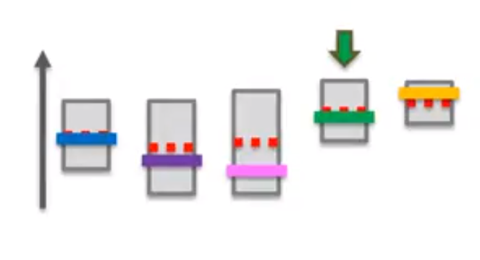
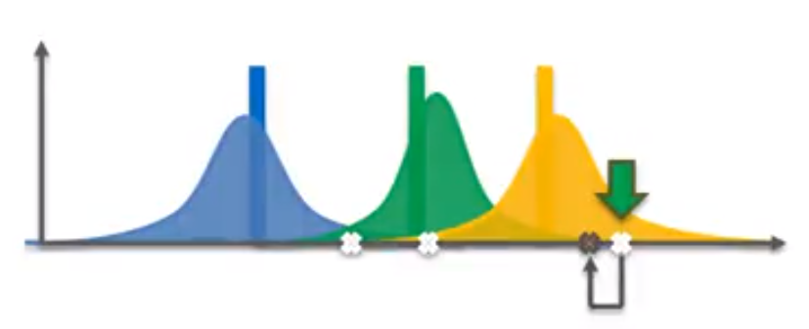
UCB
Thompson Sampling
Deterministic Algorithm
Required update at every round
Probabilistic Algorithm
Can accommodated delayed feedback
Better empirical experiment

Slide 17
References
Sutton, R. S., & Barto, A. G. (2018). Reinforcement learning: An introduction. MIT press.
Auer, P. (2002). Using confidence bounds for exploitation-exploration trade-offs. Journal of Machine Learning Research, 3(Nov), 397-422.
Silver, D, Introduction to Reinforcement Learning (Lecture note)
Restelli, M, Reinforcement Learning Exploration vs Exploitation (Lecture note)
https://www.superdatascience.com/pages/machine-learning
https://github.com/wumo/Reinforcement-Learning-An-Introduction

