Slide 1
Large-Scale Recommendation
Presented by Mengli Hua

Slide 2
Why need to talk large-scale recommendation
Why need to talk large-scale recommendation
Content
1
2
How to deal with large-scale recommendation
3
Implementation

Slide 3
Differences
Large-Scale Data
Big Data
Usually associated to large volume of data following into an application
Or are any analysis usually at a very frequent basis
Can be associated with data that grows to a huge size over time
Is held by conventional data warehousing solutions
Notes:
Reference:
https://www.quora.com/What-is-the-difference-between-big-data-and-large-scale-data-and-small-scale-data
Big Data: This can be access logs or access parents or sensor data or behaviour analysis data from a large region.
Large-scale Data: This can be credit card transactions data or any sales data over the period of time. (not a standard term)

Slide 4
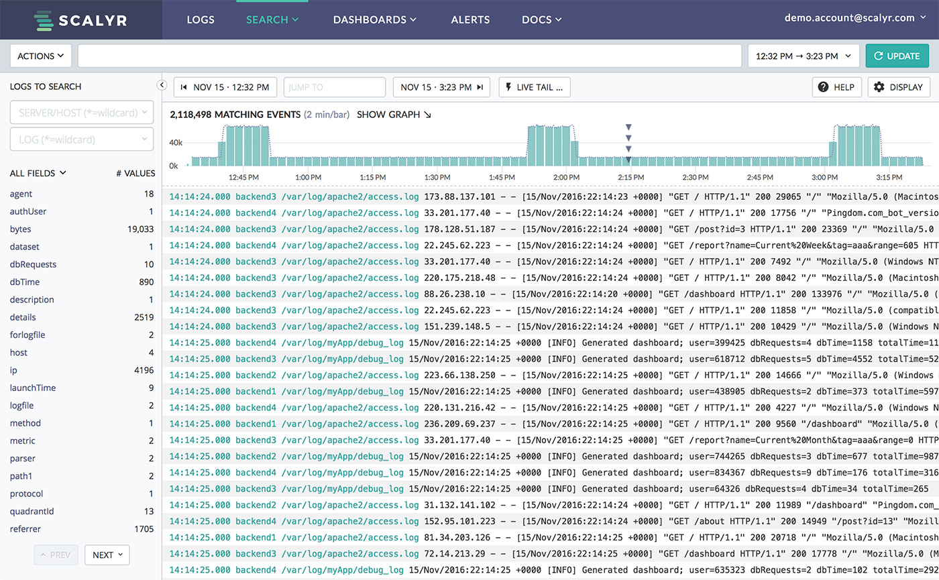
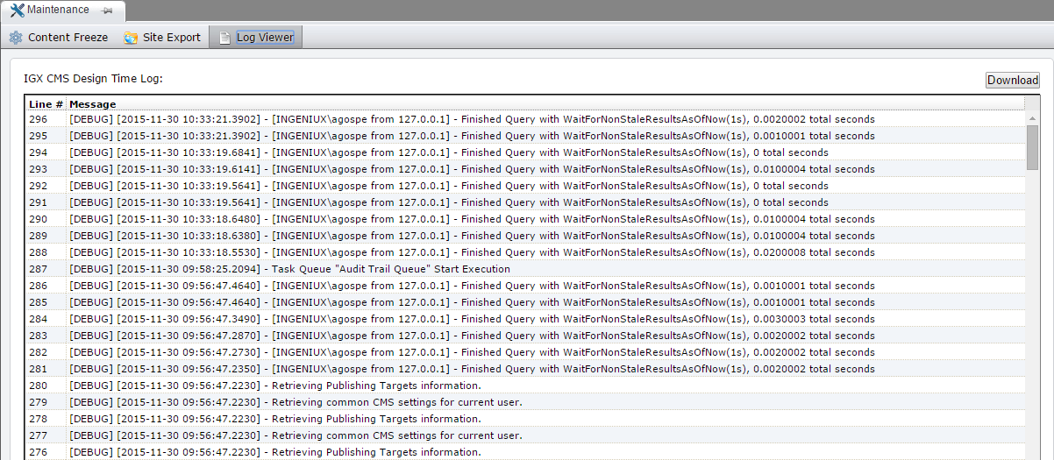
Big Data
Notes:
Pictures are downloaded from Google.

Slide 5
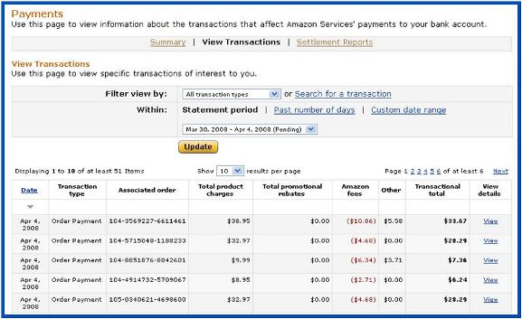
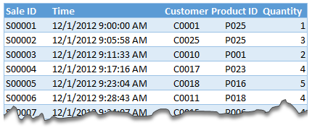
Large-Scale Data
Notes:
Pictures are downloaded from Google.

Slide 6
Facing Problems When Using Traditional Algorithm
Collaborative Filter
1
2
Computationally Expensive
Recommendation Quality
Worst Case O(MN)
M: Number of customers
N: Number of product catalog items
(since it examines M customers and up to N items for each customer)
It is possible to partially address these scaling issues by reducing the data size
All these reducing scale methods also reduce recommendation quality in several ways.
Notes:
Reference:
Linden, G., Smith, B., & York, J. (2003). Amazon.com recommendations: Item-to-item collaborative filtering. IEEE Internet Computing,7(1), 76-80. doi:10.1109/mic.2003.1167344
A traditional collaborative filtering algorithm represents a customer as an N-dimensional vector of items, where N is the number of distinct catalog items. The components of the vector are positive for purchased or positively rated items and negative for negatively rated items.
However, because the average customer vector is extremely sparse, the algorithm’s performance tends to be closer to O(M + N). Scanning every customer is approximately O(M), not O(MN), because almost all customer vectors contain a small number of items, regardless of the size of the catalog. But there are a few customers who have purchased or rated a significant percentage of the catalog, requiring O(N) processing time. Thus, the final performance of the algorithm is approximately O(M + N). Even so, for very large data sets — such as 10 million or more customers and 1 million or more catalog items — the algorithm encounters severe performance and scaling issues.
Can reduce M by randomly sampling the customers or discarding customers with few purchases and reduce N by discarding very popular or unpopular items. It is also possible to reduce the number of items examined by a small, constant factor by partitioning the item space based on product category or subject classification. Dimensionality reduction techniques such as clustering and principal component analysis can reduce M or N by a large factor.
First, if the algorithm examines only a small customer sample, the selected customers will be less similar to the user. Second, item-space partitioning restricts recommendations to a specific product or subject area. Third, if the algorithm discards the most popular or unpopular items, they will never appear as recommendations, and customers who have purchased only those items will not get recommendations.
Dimensionality reduction techniques applied to the item space tend to have the same effect by eliminating low-frequency items. Dimensionality reduction applied to the customer space effectively groups similar customers into clusters; as we now describe, such clustering can also degrade recommendation quality.

Slide 7
Facing Problems When Using Traditional Algorithm
Cluster Models
1
2
Scalability & Performance
Recommendation Quality
Better online scalability and performance than CF
The complex and expensive clustering computation is run offline.
Less similar customers in a cluster, the recommendations they produce are less relevant
Notes:
Reference:
Linden, G., Smith, B., & York, J. (2003). Amazon.com recommendations: Item-to-item collaborative filtering. IEEE Internet Computing,7(1), 76-80. doi:10.1109/mic.2003.1167344
To find customers who are similar to the user, cluster models divide the customer base into many segments and treat the task as a classification problem.
Cluster models have better online scalability and performance than collaborative filtering because they compare the user to a controlled number of segments rather than the entire customer base.
It is possible to improve quality by using numerous finegrained segments, but then online user–segment classification becomes almost as expensive as finding similar customers using collaborative filtering.

Slide 8
Facing Problems When Using Traditional Algorithm
Search-Based Methods
1
Recommendation Quality
2
Cold Start & Royalty User
Scaling and performing well for the user has few purchases or ratings.
For users with thousands of purchases, however, it’s impractical to base a query on all the items.
Must use a subset or summary of the data, which reducing quality
Popular items by the same author or in the same subject category fail to achieve this goal.
Notes:
Reference:
Linden, G., Smith, B., & York, J. (2003). Amazon.com recommendations: Item-to-item collaborative filtering. IEEE Internet Computing,7(1), 76-80. doi:10.1109/mic.2003.1167344
Search- or content-based methods treat the recommendations problem as a search for related items.
Given the user’s purchased and rated items, the algorithm constructs a search query to find other popular items by the same author, artist, or director, or with similar keywords or subjects.
The algorithm must use a subset or summary of the data, reducing quality. In all cases, recommendation quality is relatively poor. The recommendations are often either too general (such as best-selling drama DVD titles) or too narrow (such as all books by the same author).
Recommendations should help a customer find and discover new, relevant, and interesting items.

Slide 9
Broadly Use
01
02
03
Used to improve customer experience.
Used to increase sales.
Used to find similar users for further use.
Retail
Media
Others
Notes:
Perhaps the most important use of recommendation systems is at on-line retailers.

Slide 10
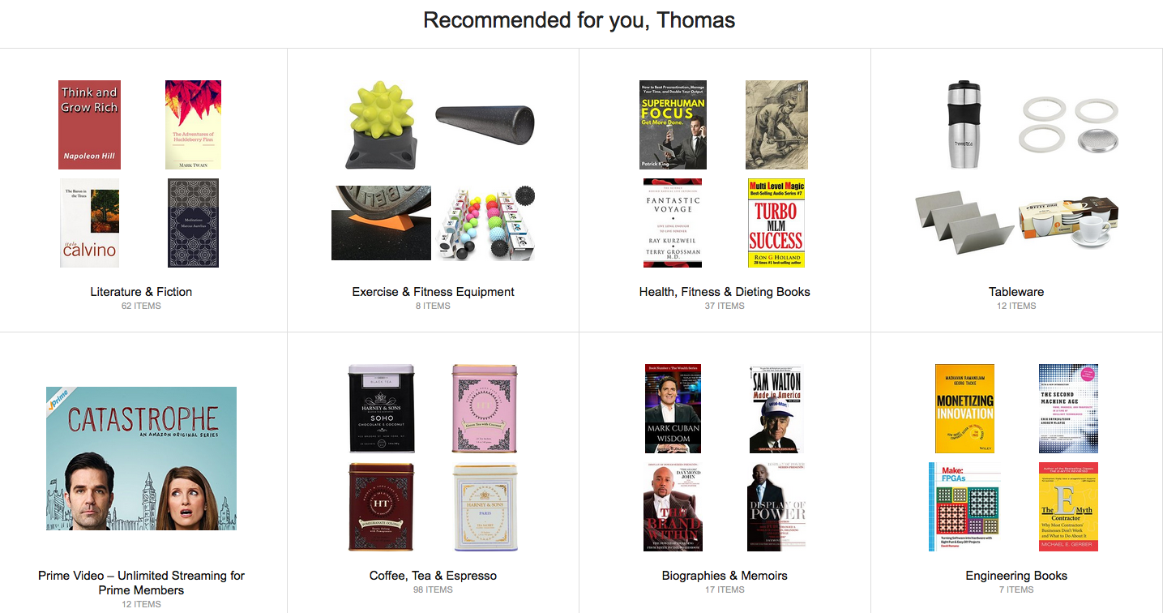
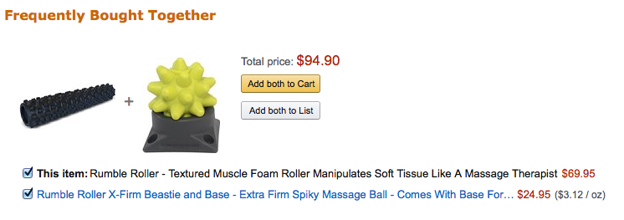
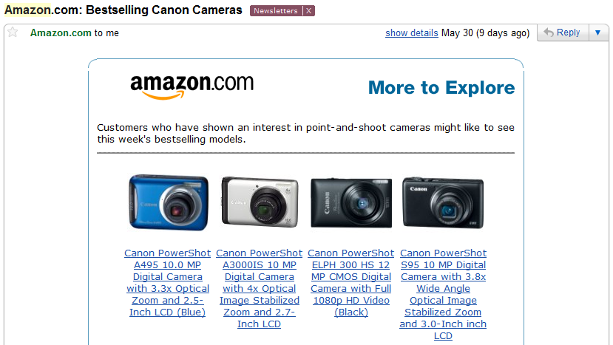
Amazon.com
Notes:
Pictures are downloaded from Google.

Slide 11
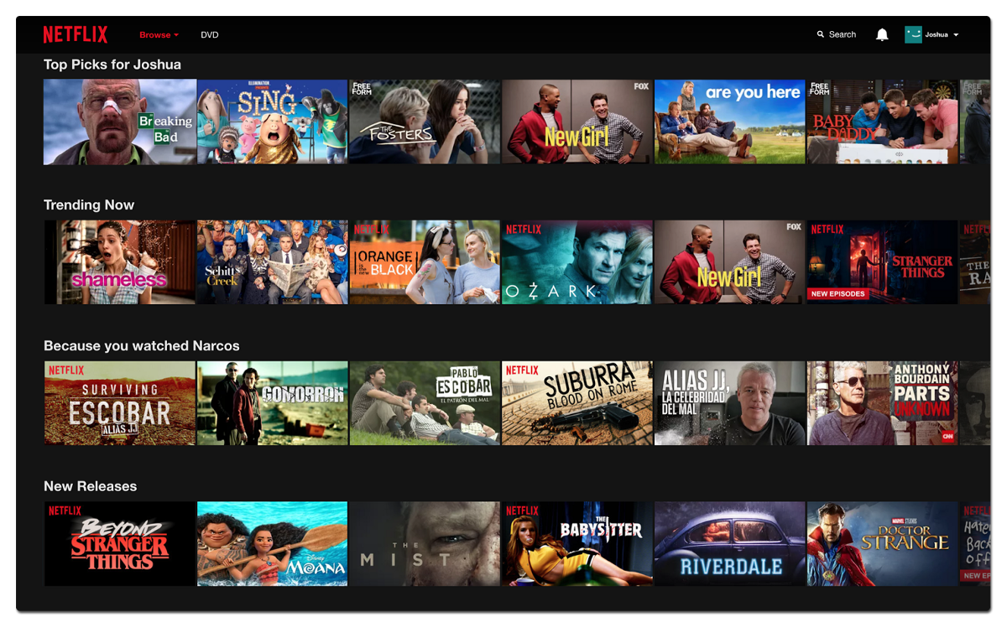
Netflix
Notes:
Pictures are downloaded from Google.
The importance of predicting ratings accurately is so high, that Netflix offered a prize of one million dollars for the first algorithm that could beat its own recommendation system by 10%. The prize was finally won in 2009, by a team of researchers called “Bellkor’s Pragmatic Chaos,” after over three years of competition.
News services have attempted to identify articles of interest to readers, based on the articles that they have read in the past. The similarity might be based on the similarity of important words in the documents, or on the articles that are read by people with similar reading tastes.

Slide 12
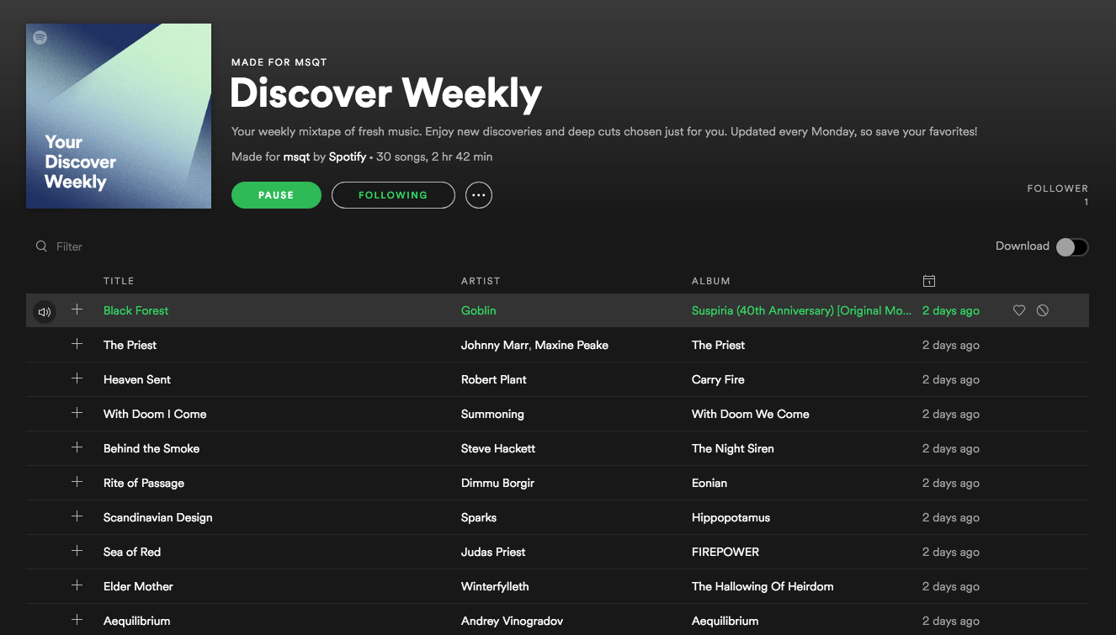
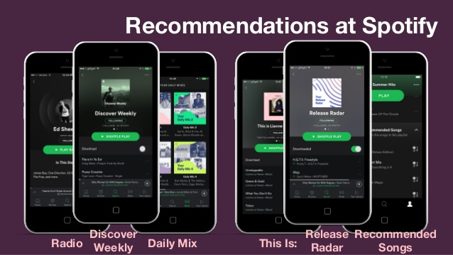
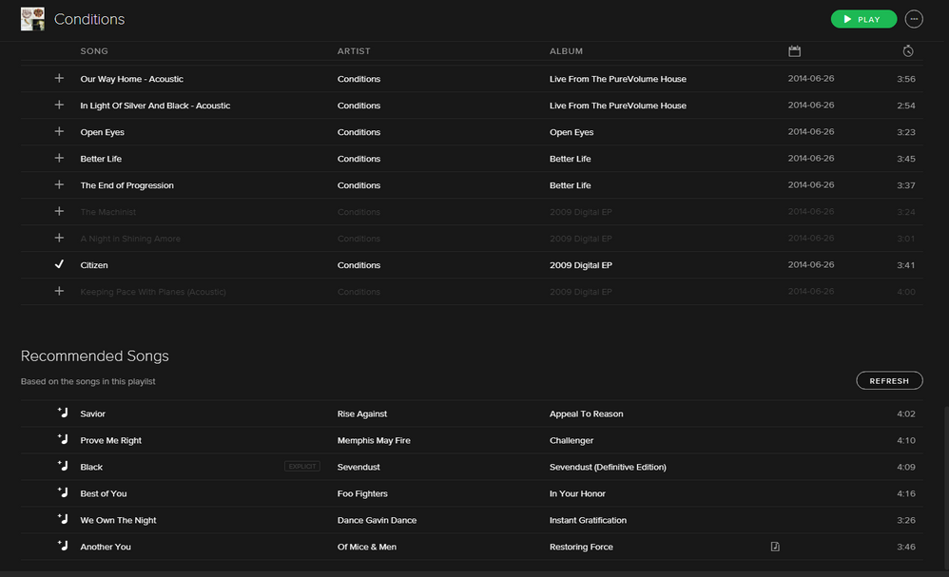
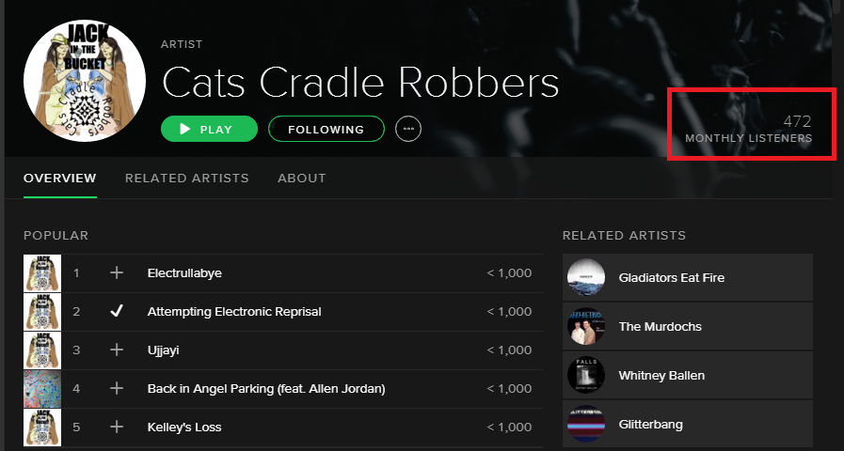
Spotify
Notes:
Pictures are downloaded from Google.

Slide 13
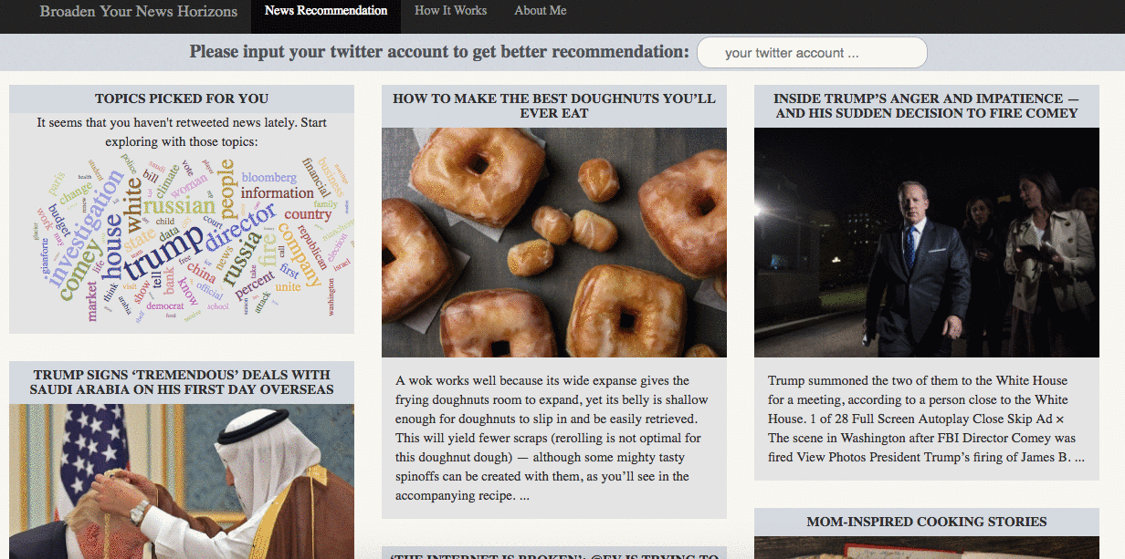
News Services
Notes:
Pictures are downloaded from Google.
News services have attempted to identify articles of interest to readers, based on the articles that they have read in the past. The similarity might be based on the similarity of important words in the documents, or on the articles that are read by people with similar reading tastes.

Slide 14
Why need to talk large-scale recommendation
Why need to talk large-scale recommendation
Content
1
2
How to deal with large-scale recommendation
How to deal with large-scale recommendation
3
Implementation

Slide 15
Before Start A Recommendation
1
POINT
Understand which kind of data can be used for recommendation.
-- e.g.: Health Care Industry
You SHOULD…
2
POINT
Determine which method will perform better for your case.
3
POINT
Make sure you have a large enough training dataset.
4
POINT
Remember the original purpose is to improve user experience.
Notes:
1. Health care products sales. (need far more specialist info)
2. There is not exist a method suits for all cases.
3. Inefficient data will lead to a less relative recommend.
4. DO NOT do things that will let users feel uncomfortable. (especially when collecting data)

Slide 16
01
Software & platform
02
BigData:
-- Hadoop, Spark, MapReduce
Language
03
Algorithm:
-- Python, R
Other resources
Tutorials
Articles
Labs
References Can Be Reach

Slide 17
Tutorials
Large-Scale Recommendation System with Python and Spark
(https://www.youtube.com/watch?v=oAByzl71Ak4)
Building a Large-Scale Recommendation Engine with Spark and Redis ML
(https://www.youtube.com/watch?v=lAJxFKD_nXk)
How to Build a Recommendation System for Purchase Data (Step-by-Step)
(https://medium.com/datadriveninvestor/how-to-build-a-recommendation-system-for-purchase-data-step-by-step-d6d7a78800b6)
Use Algorithms to Recommend Items to Customers in Python
(https://towardsdatascience.com/use-algorithms-to-recommend-items-to-customers-in-python-347b769b21f3)
Building and Running a Recommendation Engine at Any Scale
(https://aws.amazon.com/blogs/big-data/building-and-running-a-recommendation-engine-at-any-scale/)

Slide 18
Books & Articles
Recommendation Systems – Stanford InfoLab
(http://infolab.stanford.edu/~ullman/mmds/ch9.pdf)
Recombee blog -- Medium
(https://medium.com/recombee-blog)
Item-Based Collaborative Filtering Recommendation Algorithms
(http://delivery.acm.org/10.1145/380000/372071/p285-sarwar.pdf?ip=129.119.235.9&id=372071&acc=ACTIVE%20SERVICE&key=F82E6B88364EF649%2E15D8CE2BE55FDC61%2E4D4702B0C3E38B35%2E4D4702B0C3E38B35&__acm__=1549918822_3587adf6eee1424328231d33cc160de2)
Large-Scale Parallel Collaborative Filtering for the Netflix Prize
(https://link.springer.com/chapter/10.1007/978-3-540-68880-8_32)
Hybrid Personalized Recommender System Using Modified Fuzzy C-Means Clustering Algorithm
(http://citeseerx.ist.psu.edu/viewdoc/download?doi=10.1.1.741.3002&rep=rep1&type=pdf)

Slide 19
R Labs
BUILDING A MOVIE RECOMMENDATION ENGINE WITH R
(https://muffynomster.wordpress.com/2015/06/07/building-a-movie-recommendation-engine-with-r/)
Building a Movie Recommendation System
(https://rpubs.com/jeknov/movieRec)
Worked out example: Item based Collaborative filtering for Recommender Engine
(https://ashokharnal.wordpress.com/2014/12/18/worked-out-example-item-based-collaborative-filtering-for-recommenmder-engine/)
Item Based Collaborative Filtering Recommender Systems in R
(https://www.r-bloggers.com/item-based-collaborative-filtering-recommender-systems-in-r/)
IBCF / UBCF - Movie Recommendation System - R Notebook
MovieLense Recommendation System in R
(http://rstudio-pubs-static.s3.amazonaws.com/248530_18970dc8eb4046a6b4f2fba987fe2a50.html)

Slide 20
Why need to talk large-scale recommendation
Why need to talk large-scale recommendation
Content
1
2
How to deal with large-scale recommendation
How to deal with large-scale recommendation
3
Implementation
Implementation

Slide 21
R Lab
01
02
Exploring Parameters of Recommendation Models
Exploring Similarity Data
03
04
Normalizing Data
Further Data Exploration
05
06
Binarizing data
Applying ITEM-based Collaborative Filtering Model

Slide 22
Used Materials
Reference Tutorial:
https://rpubs.com/jeknov/movieRec
Data sets:
https://grouplens.org/datasets/movielens/latest/
(I choose the small one for today’s tutorial)
R packages:
recommenderlab
https://cran.r-project.org/web/packages/recommenderlab/index.html
ggplot2
https://cran.r-project.org/web/packages/ggplot2/index.html
data.table
https://cran.r-project.org/web/packages/data.table/index.html
reshape2
https://cran.r-project.org/web/packages/reshape2/index.html

